Slide 1
Data Analytics Lifecycle
Data Analytics Lifecycle Overview
Phase 1: Discovery
Phase 2: Data Preparation
Phase 3: Model Planning
Phase 4: Model Building
Phase 5: Communicate Results
Phase 6: Operationalize
Case Study:

Slide 2
Data Analytics Lifecycle Overview
The data analytic lifecycle is designed for Complex Data problems and data science projects
With six phases the project work can occur in several phases simultaneously
The cycle is iterative to portray a real project
Work can return to earlier phases as new information is uncovered

Slide 3
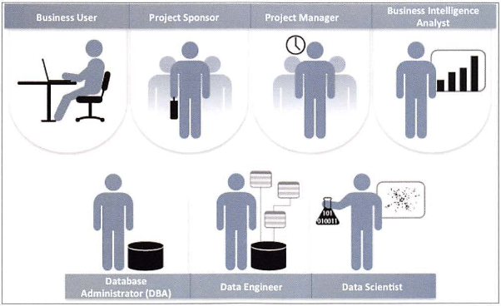
Key Roles for a Successful Analytics Project

Slide 4
Key Roles for a Successful Analytics Project
Business User – understands the domain area
Project Sponsor – provides requirements
Project Manager – ensures meeting objectives
Business Intelligence Analyst – provides business domain expertise based on deep understanding of the data
Database Administrator (DBA) – creates DB environment
Data Engineer – provides technical skills, assists data management and extraction, supports analytic sandbox
Data Scientist – provides analytic techniques and modeling

Slide 5
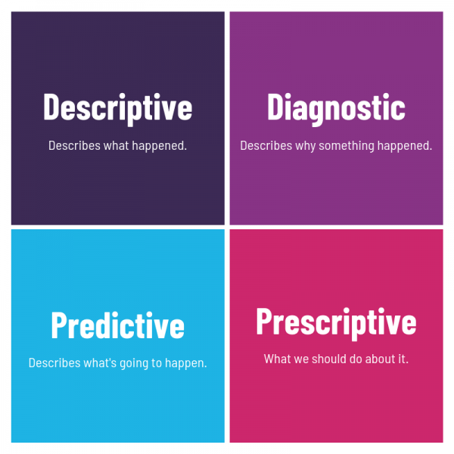
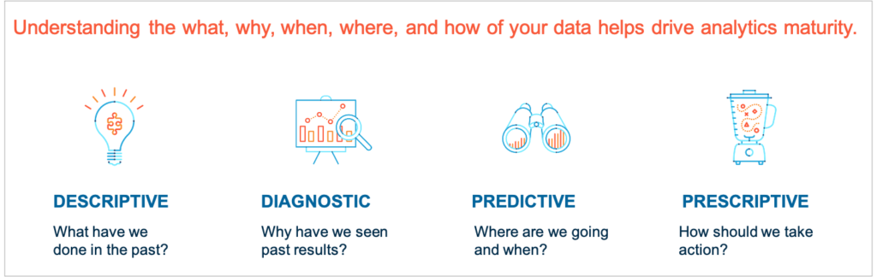
Four Types of Data Analytics

Slide 6
Types of Analytics
Descriptive: A set of techniques for reviewing and examining the data set(s) to understand the data and analyze business performance.
Diagnostic: A set of techniques for determine what has happened and why
Predictive: A set of techniques that analyze current and historical data to determine what is most likely to (not) happen
Prescriptive: A set of techniques for computationally developing and analyzing alternatives that can become courses of action – either tactical or strategic – that may discover the unexpected

Slide 7
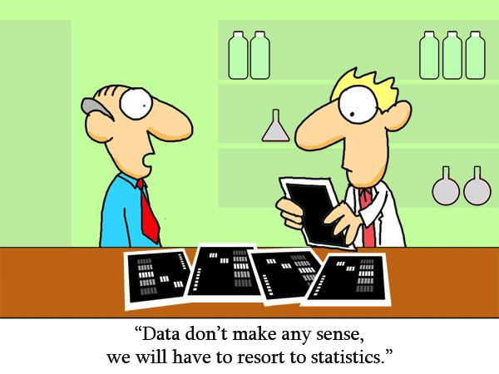
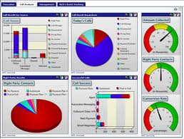
Descriptive Analytics
Identify the attributes, then assess/evaluate the attributes
Estimate the magnitude to correlate the relative contribution of each attribute to the final solution
Accumulate more instances of data from the data sources
If possible, perform the steps of evaluation, classification and categorization quickly
Yield a measure of adaptability within the OODA loop
At some threshold, crossover into diagnostic and predictive analytics

Slide 8

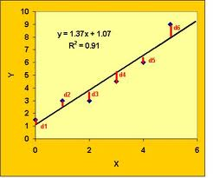
Diagnostic Analytics
Begin with descriptive analytics
Extract patterns from large data quantities via data mining
Correlate data types for explanation of near-term behavior – past and present
Estimate linear/non-linear behavior not easily identifiable through other approaches.
Example: by classifying past insurance claims, estimate the number of future claims to flag for investigation with a high probability of being fraudulent.

Slide 9

Predictive Analytics
Begin with descriptive AND diagnostic analytics
Choose the right data based on domain knowledge and relationships among variables
Choose the right techniques to yield insight into possible outcomes
Determine the likelihood of possible outcomes given initial boundary conditions

Slide 10
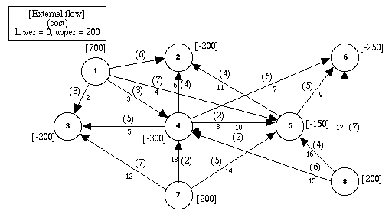
Prescriptive Analytics
Process:
Begin w/ predictive analytics
Determine what should occur and how to make it so
Determine the mitigating factors that lead to desirable/undesirable outcomes
“What-if” analysis w/ local or global optimization
Ex: Find the best set of prices and advertising frequency to maximize revenue
Ex: And, the right set of business moves to make to achieve that goal
“Make it so”

Slide 11
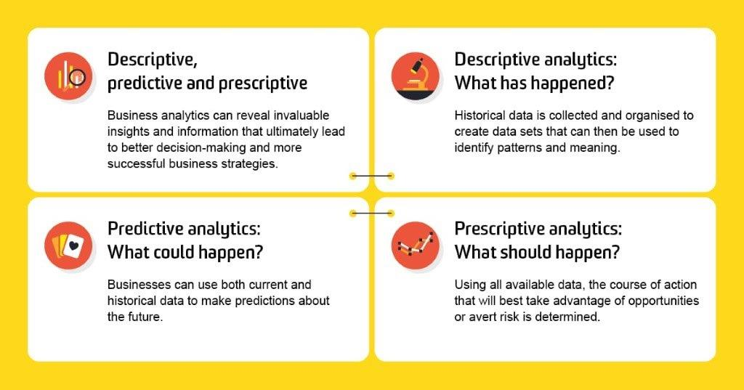

Slide 12
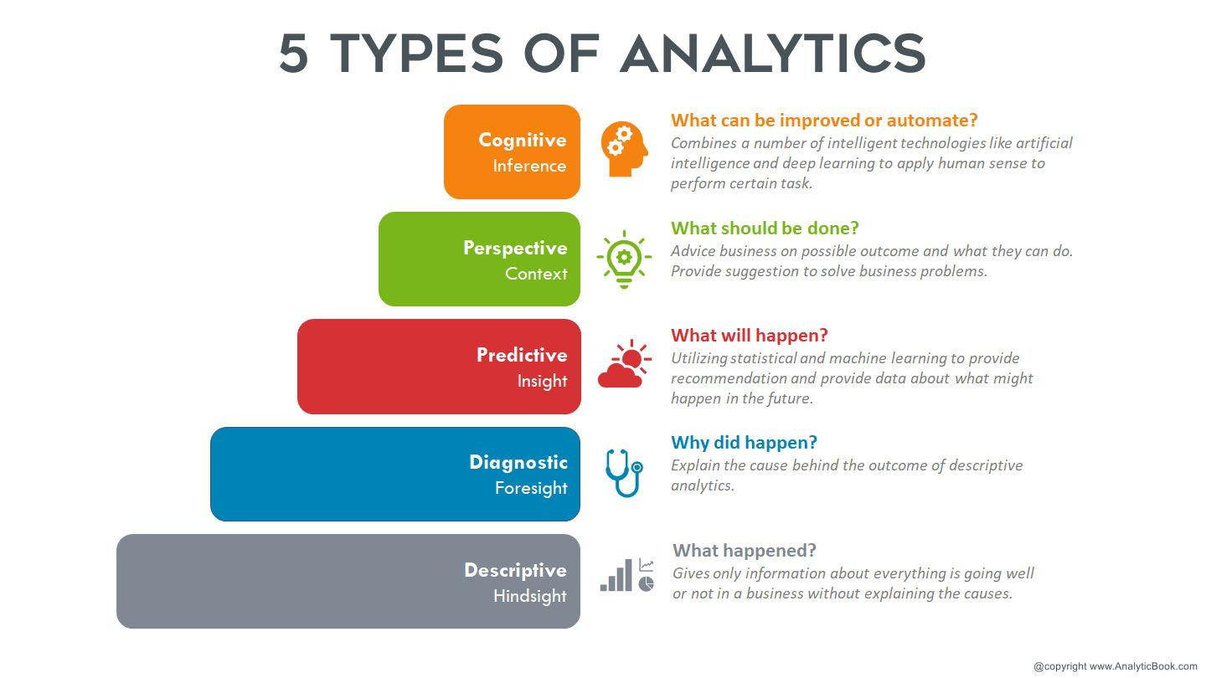

Slide 13
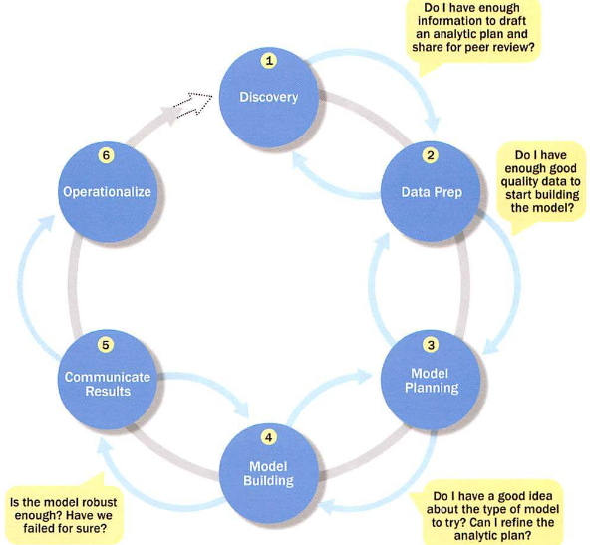
Overview of Data Analytics Lifecycle

Slide 14
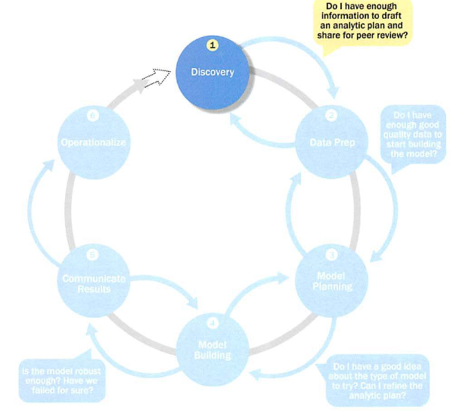
Phase 1: Discovery

Slide 15
Phase 1: Discovery
Learning the Business Domain
Resources
Framing the Problem
Identifying Key Stakeholders
Interviewing the Analytics Sponsor
Developing Initial Hypotheses
Identifying Potential Data Sources

Slide 16
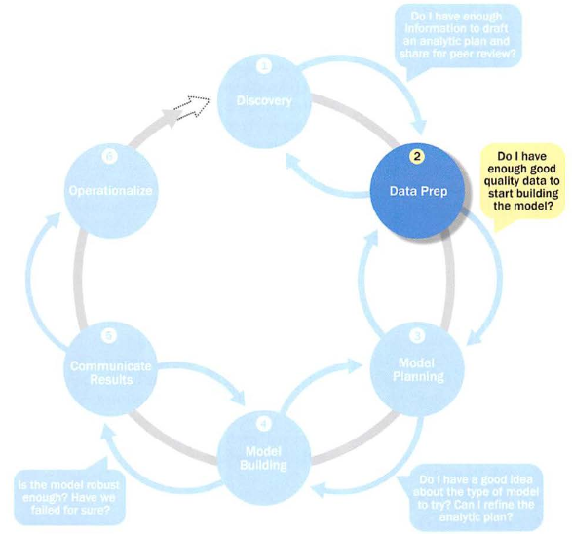
Phase 2: Data Preparation

Slide 17
Phase 2: Data Preparation
Includes steps to explore, preprocess, and condition data
Create robust environment – analytics sandbox
Data preparation tends to be the most labor-intensive step in the analytics lifecycle
Often at least 50% of the data science project’s time
The data preparation phase is generally the most iterative and the one that teams tend to underestimate most often

Slide 18
Preparing the Analytic Sandbox
Create the analytic sandbox (also called workspace)
Allows team to explore data without interfering with live production data
Sandbox collects all kinds of data (expansive approach)
The sandbox allows organizations to undertake ambitious projects beyond traditional data analysis and BI to perform advanced predictive analytics
Although the concept of an analytics sandbox is relatively new, this concept has become acceptable to data science teams and IT groups

Slide 19
Performing ETLT (Extract, Transform, Load, Transform)
In ETL users perform extract, transform, load
In the sandbox the process is often ELT – early load preserves the raw data which can be useful to examine
Example – in credit card fraud detection, outliers can represent high-risk transactions that might be inadvertently filtered out or transformed before being loaded into the database
New technologies Hadoop, NoSQL etc are used here

Slide 20
Learning about the Data
Becoming familiar with the data is critical
This activity accomplishes several goals:
Determines the data available to the team early in the project
Highlights gaps – identifies data not currently available
Identifies data outside the organization that might be useful

Slide 21
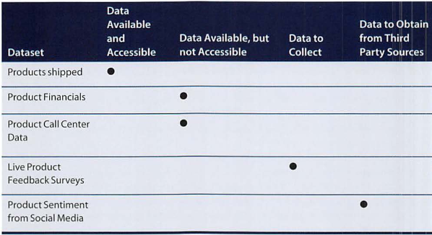
Learning about the Data Sample Dataset Inventory

Slide 22
Data Conditioning
Data conditioning includes cleaning data, normalizing datasets, and performing transformations
Often viewed as a preprocessing step prior to data analysis, it might be performed by data owner, IT department, DBA, etc.
Best to have data scientists involved
Data science teams prefer more data than too little

Slide 23
Data Conditioning
Additional questions and considerations
What are the data sources? Target fields?
How clean is the data?
How consistent are the contents and files? Missing or inconsistent values?
Assess the consistency of the data types – numeric, alphanumeric?
Review the contents to ensure the data makes sense
Look for evidence of systematic error

Slide 24
Survey and Visualize
Leverage data visualization tools to gain an overview of the data
Review data to ensure calculations are consistent
Does the data distribution stay consistent?
Assess the granularity of the data, the range of values, and the level of aggregation of the data
Does the data represent the population of interest?
Check time-related variables – daily, weekly, monthly? Is this good enough?
Is the data standardized/normalized? Scales consistent?
For geospatial datasets, are state/country abbreviations consistent

Slide 25
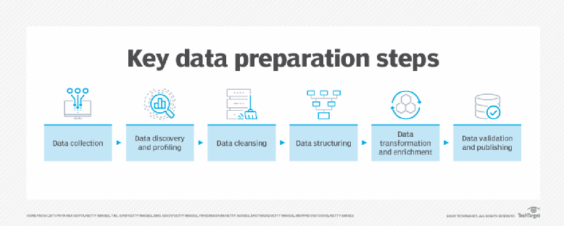
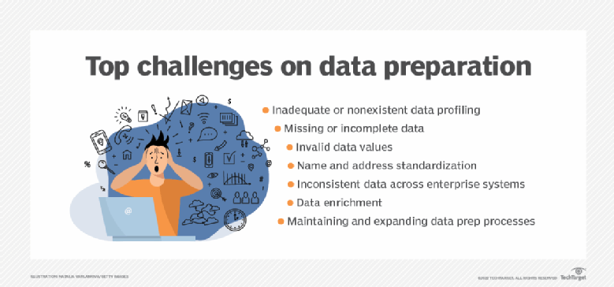

Slide 26
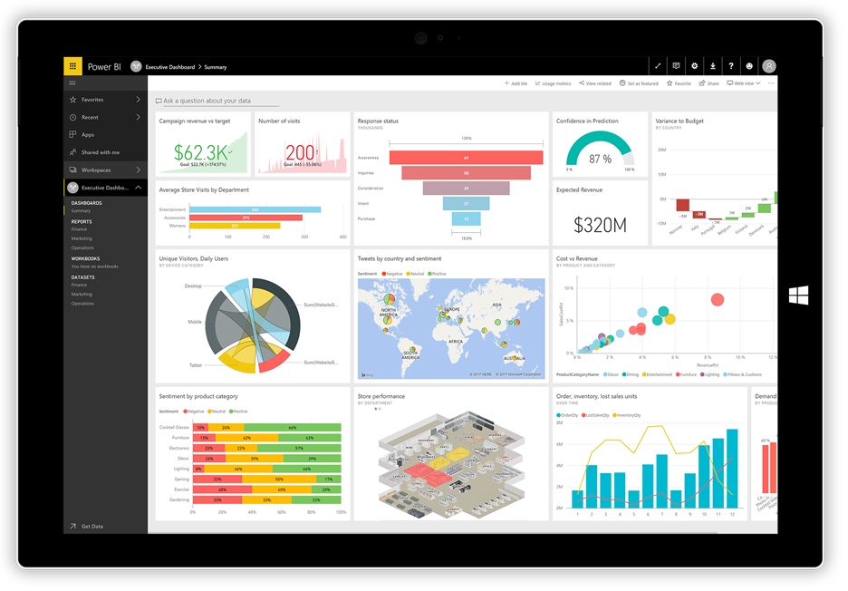
Common Tools for Data Preparation Microsoft Power BI

Slide 27
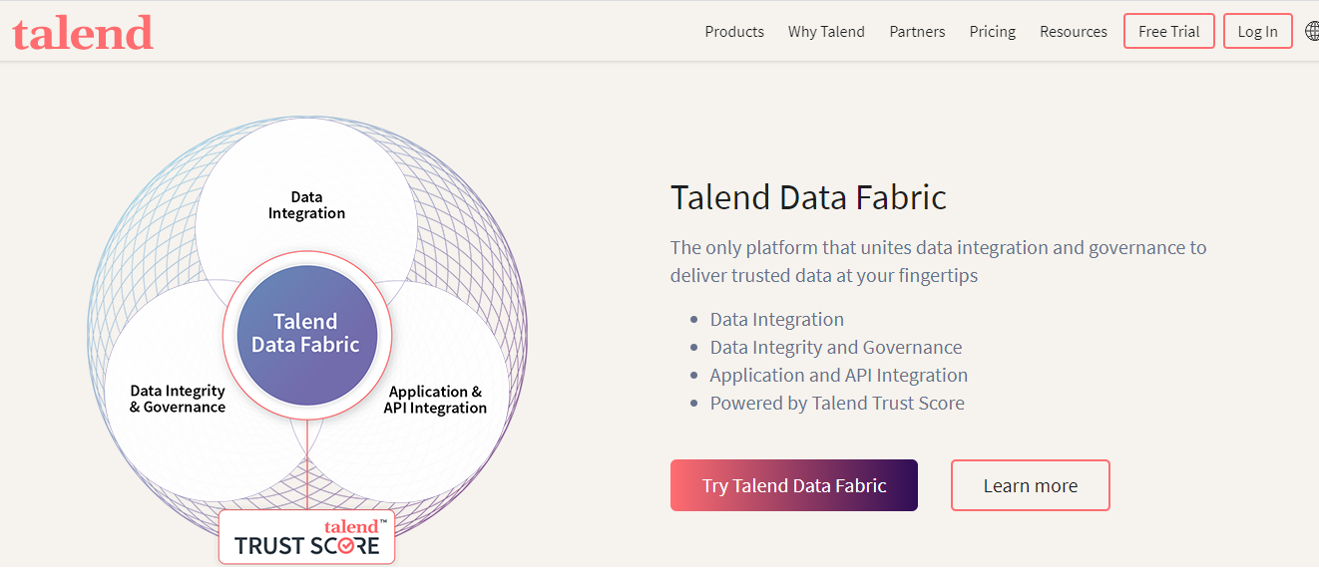
Tools

Slide 28
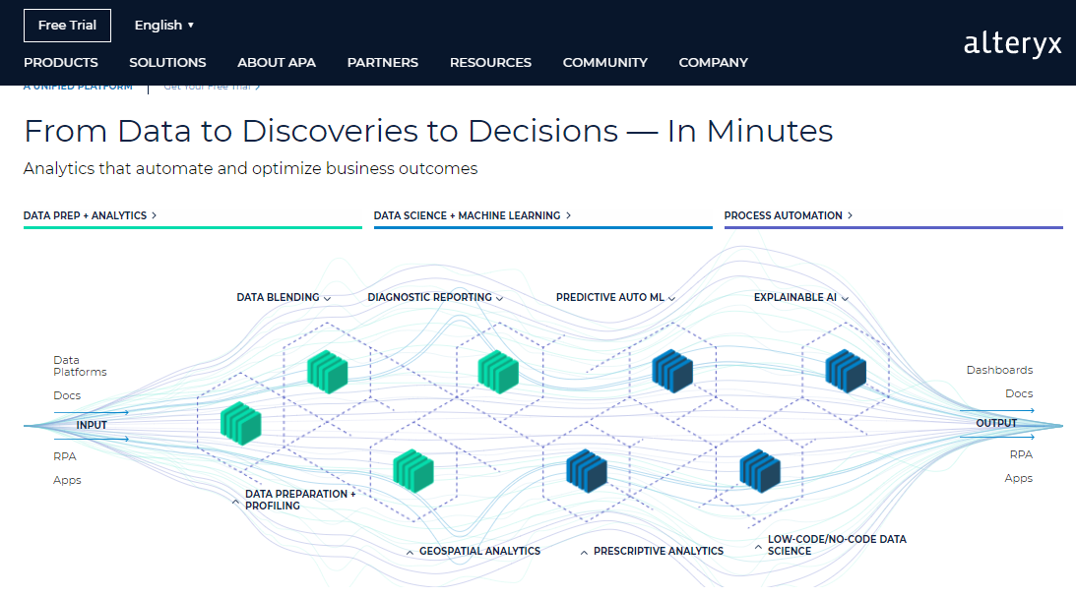

Slide 29
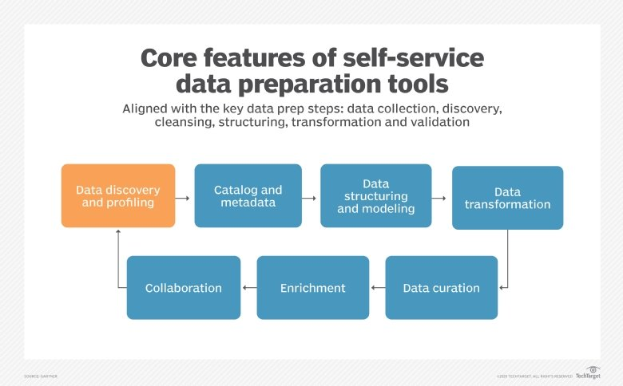
Data Preparation Tools
Trifacta
Datameer
Databricks
Altair
IBM
Tablaeu

Slide 30
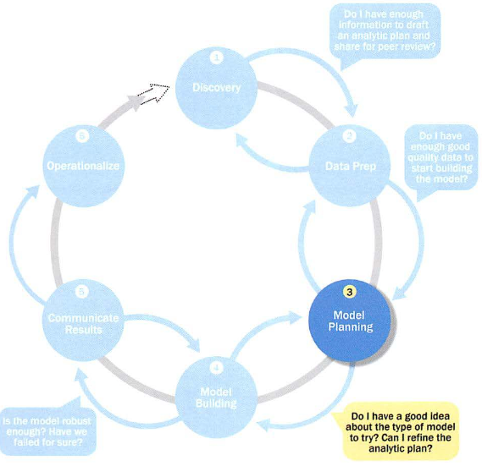
Phase 3: Model Planning

Slide 31
Phase 3: Model Planning
Activities to consider
Assess the structure of the data – this dictates the tools and analytic techniques for the next phase
Ensure the analytic techniques enable the team to meet the business objectives and accept or reject the working hypotheses
Determine if the situation warrants a single model or a series of techniques as part of a larger analytic workflow
Research and understand how other analysts have approached this kind or similar kind of problem

Slide 32
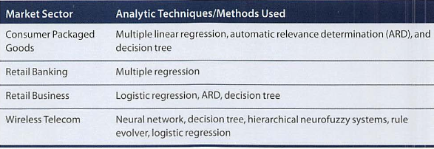
Phase 3: Model Planning Model Planning in Industry Verticals
Example of other analysts approaching a similar problem

Slide 33
Data Exploration and Variable Selection
Explore data to understand the relationships among the variables & thus selection of the variables and methods
A common way to do this – data visualization tools
Stakeholders and subject matter experts may have ideas
For example, some hypothesis that led to the project
Aim for capturing the most essential predictors & variables
This often requires iterations and testing to identify key variables
If the team plans to run regression analysis, identify the candidate predictors and outcome variables of the model

Slide 34
Model Selection
The main goal is to choose an analytical technique, or several candidates, based on the end goal of the project
We observe events in the real world and attempt to construct models that emulate this behavior with a set of rules and conditions
Determine whether to use techniques best suited for structured data, unstructured data, or a hybrid approach
Teams often create initial models using statistical software packages such as R, SAS, or Matlab
Which may have limitations when applied to very large datasets
The team moves to the model building phase once it has a good idea about the type of model to try

Slide 35
Common Tools for the Model Planning Phase
R has a complete set of modeling capabilities
R contains about 5000 packages for data analysis and graphical presentation
SQL Analysis services can perform in-database analytics of common data mining functions, involved aggregations, and basic predictive models
SAS/ACCESS provides integration between SAS and the analytics sandbox via multiple data connections
Rapid Miner
Tableau Public

Slide 36
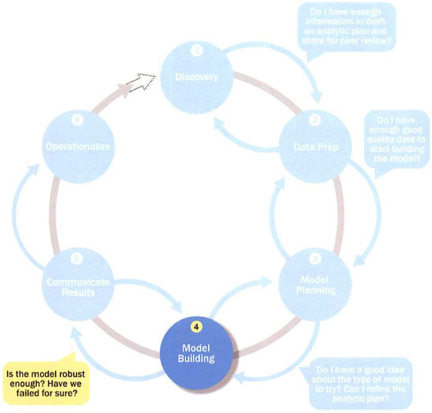
Phase 4: Model Building

Slide 37
Phase 4: Model Building
Execute the models defined in Phase 3
Develop datasets for training, testing, and production
Develop analytic model on training data, test on test data
Question to consider
Does the model appear valid and accurate on the test data?
Does the model output/behavior make sense to the domain experts?
Do the parameter values make sense in the context of the domain?
Is the model sufficiently accurate to meet the goal?
Does the model avoid intolerable mistakes?
Are more data or inputs needed?
Will the kind of model chosen support the runtime environment?
Is a different form of the model required to address the business problem?

Slide 38
Lifecycle of Model Building Phase
Select variables
Balance data
Build models
Validate
Deploy
Maintain
Define success
Explore data
Condition data

Slide 39
Common Tools for the Model Building Phase
Commercial Tools
SAS Enterprise Miner – built for enterprise-level computing & analytics
SPSS Modeler (IBM) – provides enterprise-level computing and analytics
Matlab – high-level language for data analytics, algorithms, data exploration
Alpine Miner – provides GUI frontend for backend analytics tools
Free or Open Source Tools
R and PL/R - PL/R is a procedural language for PostgreSQL with R
Octave – language for computational modeling
WEKA – data mining software package with analytic workbench
Python – language providing toolkits for machine learning and analysis

Slide 40
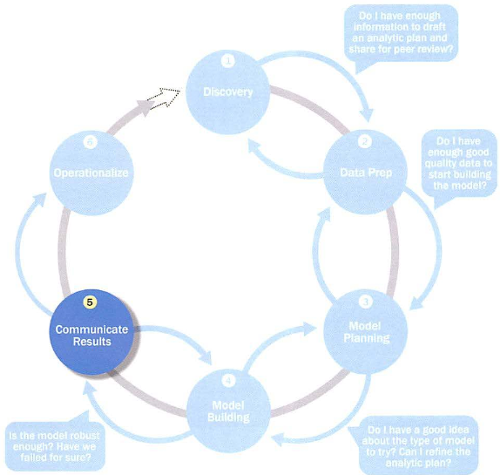
Phase 5: Communicate Results

Slide 41
Phase 5: Communicate Results
After executing model team need to compare outcomes of modeling to criteria established for success and failure.
Team considers how best to articulate findings and outcomes to various team members and stakeholders, taking into account warning, assumptions.
Team should identify key findings, quantify business value, and develop narrative to summarize and convey findings to stakeholders.

Slide 42
Phase 5: Communicate Results
Determine if the team succeeded or failed in its objectives
Assess if the results are statistically significant and valid
If so, identify aspects of the results that present salient findings
Identify surprising results and those in line with the hypotheses
Communicate and document the key findings and major insights derived from the analysis
This is the most visible portion of the process to the outside stakeholders and sponsors

Slide 43
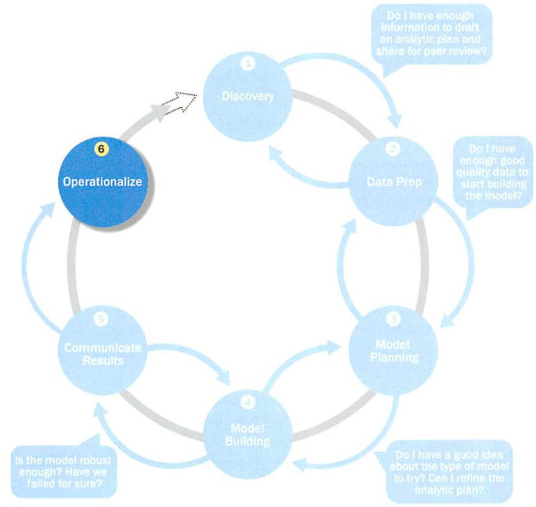
Phase 6: Operationalize

Slide 44
Phase 6: Operationalize
In this last phase, the team communicates the benefits of the project more broadly and sets up a pilot project to deploy the work in a controlled way
Risk is managed effectively by undertaking small scope, pilot deployment before a wide-scale rollout
During the pilot project, the team may need to execute the algorithm more efficiently in the database rather than with in-memory tools like R, especially with larger datasets
To test the model in a live setting, consider running the model in a production environment for a discrete set of products or a single line of business
Monitor model accuracy and retrain the model if necessary

Slide 45
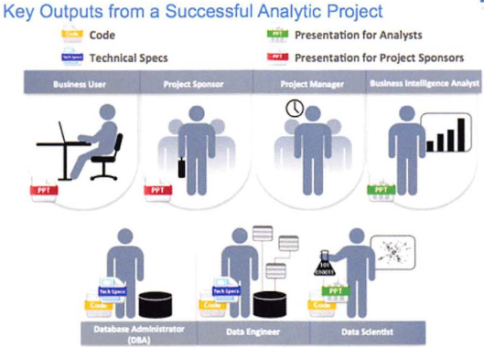
Phase 6: Operationalize Key outputs from successful analytics project

Slide 46
Phase 6: Operationalize Key outputs from successful analytics project
Business user – tries to determine business benefits and implications
Project sponsor – wants business impact, risks, ROI
Project manager – needs to determine if project completed on time, within budget, goals met
Business intelligence analyst – needs to know if reports and dashboards will be impacted and need to change
Data engineer and DBA – must share code and document
Data scientist – must share code and explain model to peers, managers, stakeholders

Slide 47
Phase 6: Operationalize Four main deliverables
Although the seven roles represent many interests, the interests overlap and can be met with four main deliverables
Presentation for project sponsors – high-level takeaways for executive level stakeholders
Presentation for analysts – describes business process changes and reporting changes, includes details and technical graphs
Code for technical people
Technical specifications of implementing the code

Slide 48
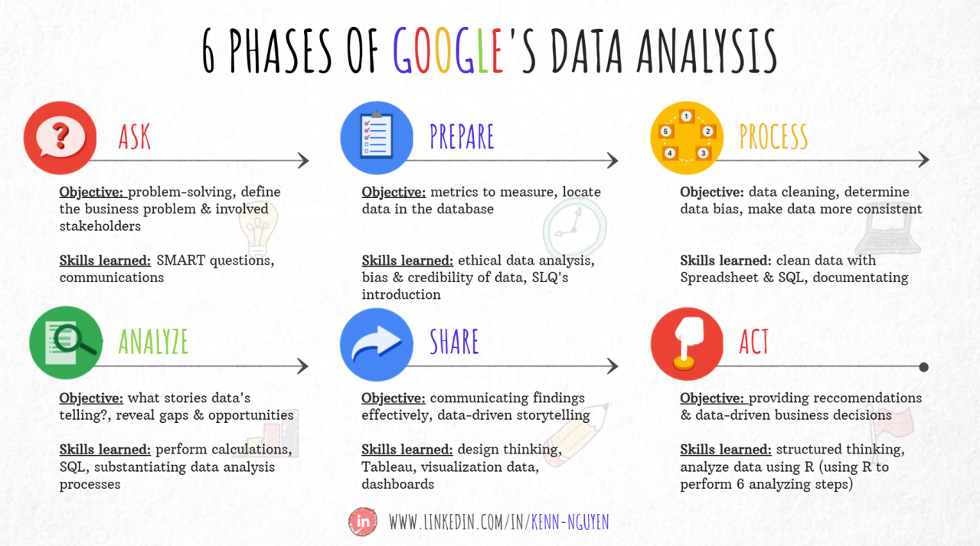

Slide 49
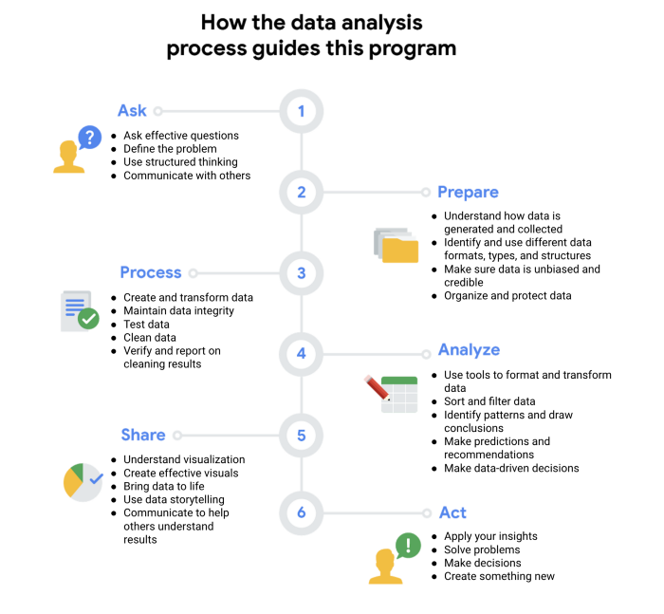

Slide 50
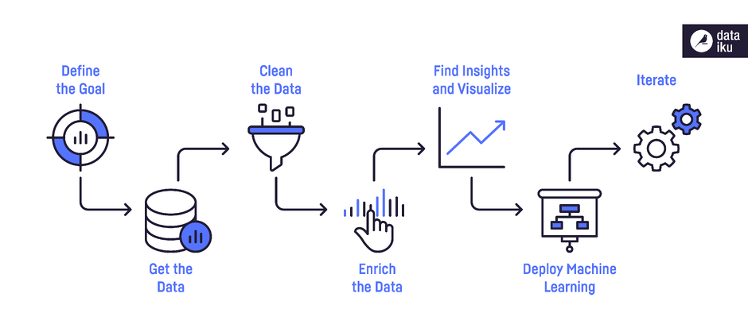
Practical Data Analytics Life Cycle

Slide 51
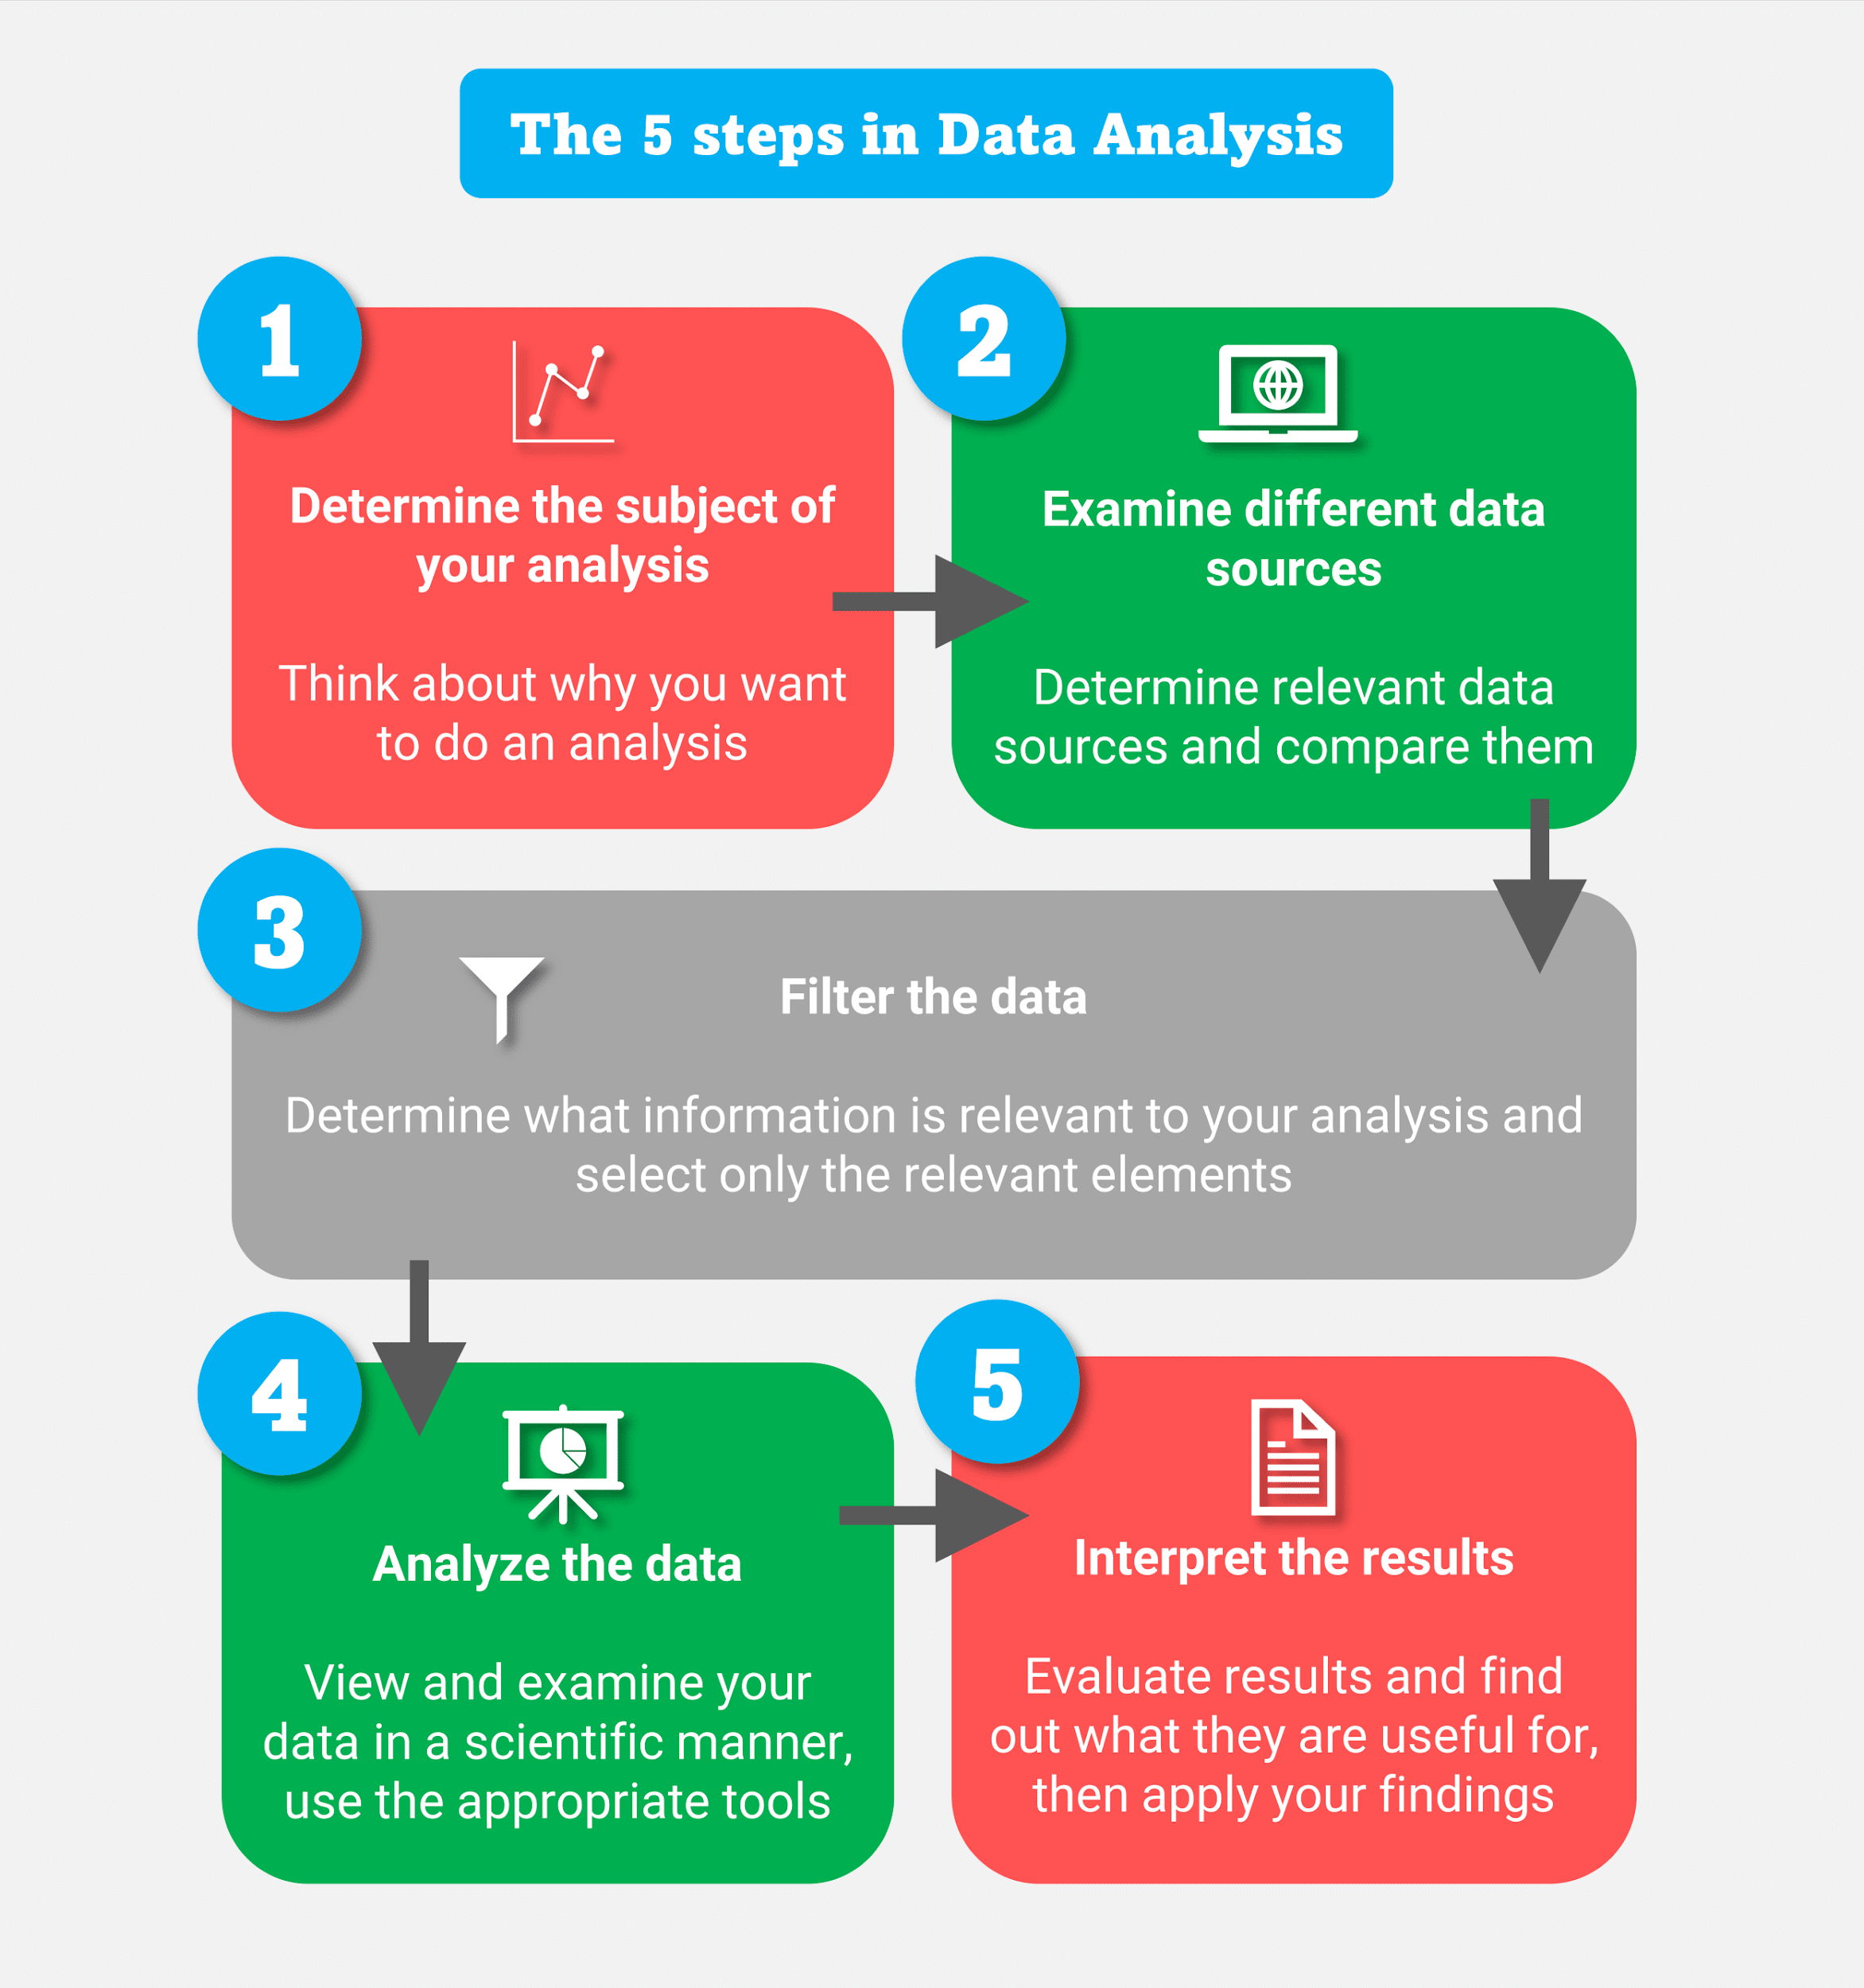

Slide 52
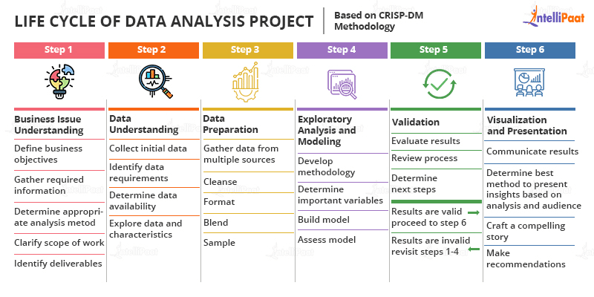
Life Cycle

Slide 53
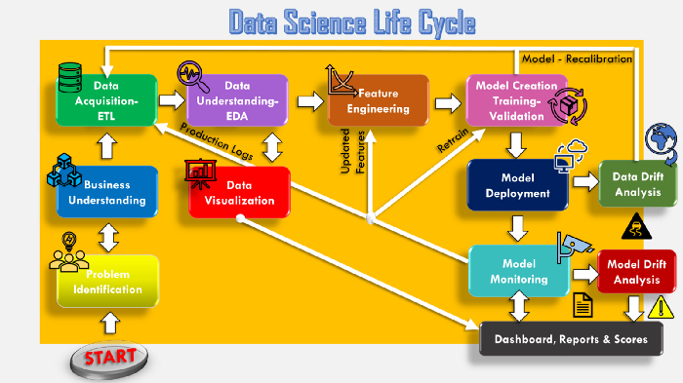

Slide 54
Case Study:
Global Innovation Network and Analysis (GINA)
EMC’s new director wanted to improve the company’s engagement of employees across the global centers of excellence (GCE) to drive innovation, research, and university partnerships
This project was created to accomplish
Store formal and informal data
Track research from global technologists
Mine the data for patterns and insights to improve the team’s operations and strategy

Slide 55
Phase 1: Discovery
Team members and roles
Business user, project sponsor, project manager – Vice President from Office of CTO
BI analyst – person from IT
Data engineer and DBA – people from IT
Data scientist – distinguished engineer

Slide 56
Phase 1: Discovery
The data fell into two categories
Five years of idea submissions from internal innovation contests
Minutes and notes representing innovation and research activity from around the world
Hypotheses grouped into two categories
Descriptive analytics of what is happening to spark further creativity, collaboration, and asset generation
Predictive analytics to advise executive management of where it should be investing in the future

Slide 57
Phase 2: Data Preparation
Set up an analytics sandbox
Discovered that certain data needed conditioning and normalization and that missing datasets were critical
Team recognized that poor quality data could impact subsequent steps
They discovered many names were misspelled and problems with extra spaces
These seemingly small problems had to be addressed

Slide 58
Phase 3: Model Planning
The study included the following considerations
Identify the right milestones to achieve the goals
Trace how people move ideas from each milestone toward the goal
Tract ideas that die and others that reach the goal
Compare times and outcomes using a few different methods

Slide 59
Phase 4: Model Building
Several analytic method were employed
NLP on textual descriptions
Social network analysis using R and Rstudio
Developed social graphs and visualizations

Slide 60
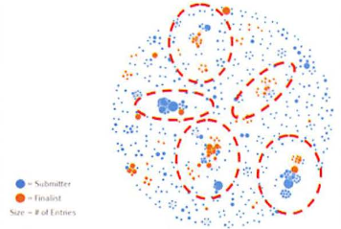
Phase 4: Model Building Social graph of data submitters and finalists

Slide 61
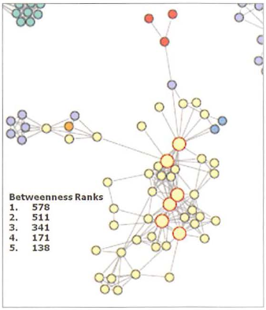
Phase 4: Model Building Social graph of top innovation influencers

Slide 62
Phase 5: Communicate Results
Study was successful in in identifying hidden innovators
Found high density of innovators in Cork, Ireland
The CTO office launched longitudinal studies

Slide 63
Phase 6: Operationalize
Deployment was not really discussed
Key findings
Need more data in future
Some data were sensitive
A parallel initiative needs to be created to improve basic BI activities
A mechanism is needed to continually reevaluate the model after deployment

Slide 64
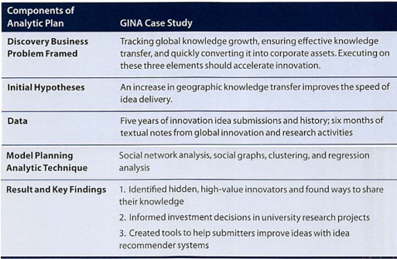
Phase 6: Operationalize

Slide 65
Summary
The Data Analytics Lifecycle is an approach to managing and executing analytic projects
Lifecycle has six phases
Bulk of the time usually spent on preparation – phases 1 and 2
Seven roles needed for a data science team

